Slide 1
Curiosity and Children’s Rights
What rights shall we pick to be our school rights?!

Slide 3
Article 1 and 2:
All children have their rights –
no matter what!
Article 3
Adults must do what is best for me.
Article 4
Government make sure I get my rights.
Article 5
My family should give me good advice.
Article 6
I should be supported to live and grow.
Article 7 & 8
Right to an identify: name, beliefs and culture.
Article 9
Live with a family that cares for me
Article 10
See my family if they live elsewhere.
Article 11
Not be taken away illegally.
Curiosity and Children’s Rights

Slide 4
Article 12
I should be listened to and taken seriously.
Article 13
Be able to share information.
Article 14
I can choose my own religion.
Article 15
I can join groups and be with friends.
Article 16
I have the right to privacy.
Article 17
I have the right to information.
Article 18
Right to be brought up by both parents – if safe.
Article 19
I should not be hurt and kept safe.
Article 20
Be protected if I cannot live with my family.
Article 21
Right to best care if adopted.
Curiosity and Children’s Rights

Slide 5
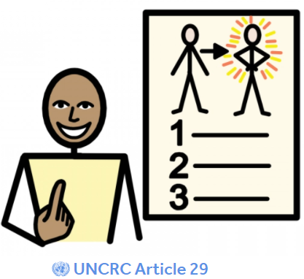
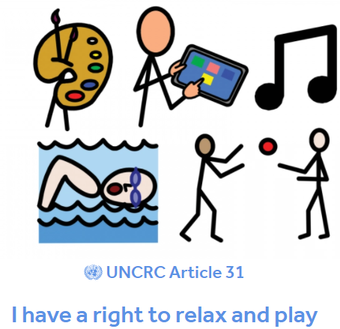
Article 22
If I am a refugee, I have rights in my new country
Article 23
Right to special care and education if I need it.
Article 24
Right to healthcare, healthy food, clean water
Article 25
Check I am safe and happy if I don’t live with my family.
Article 26
Right to money to look after me.
Article 27
Right to food, house and clothing.
Article 28
Right to an education
Article 29
Right to be the best I can be.
Article 30
Right to speak own language.
Article 31
Right to relax and play
Curiosity and Children’s Rights

Slide 6
Agree rights for our school charter
Look again at the list of rights
As we talk about them again, think about which rights you think we CAN and SHOULD focus on in school. TTYP
We will agree 4-6 rights that YOU think we should focus on in school. Make a list on Flip chart!
These will become our School Charter – an agreement or promise that we will stick to.
Once you have decided which rights you would like, Mrs Bailey, Prefects and School Council Rights Ambassadors, will create a display in the hall for our School Charter and EVERYBODY, children and adults, will sign up to it to make sure you get your rights and you are respectful that other’s receive their rights too.

Slide 7
Class Awards
Headteacher’s Awards
Attendance Award
Values – In it to Win it!

Slide 8
Reflection/Prayer Time
We hope that all children around the world receive the rights that they are entitled to in order to live a safe, happy and fulfilling life.
Help us to respect the rights of others in our choices and behaviour each day.
(Amen)

